Slide 1
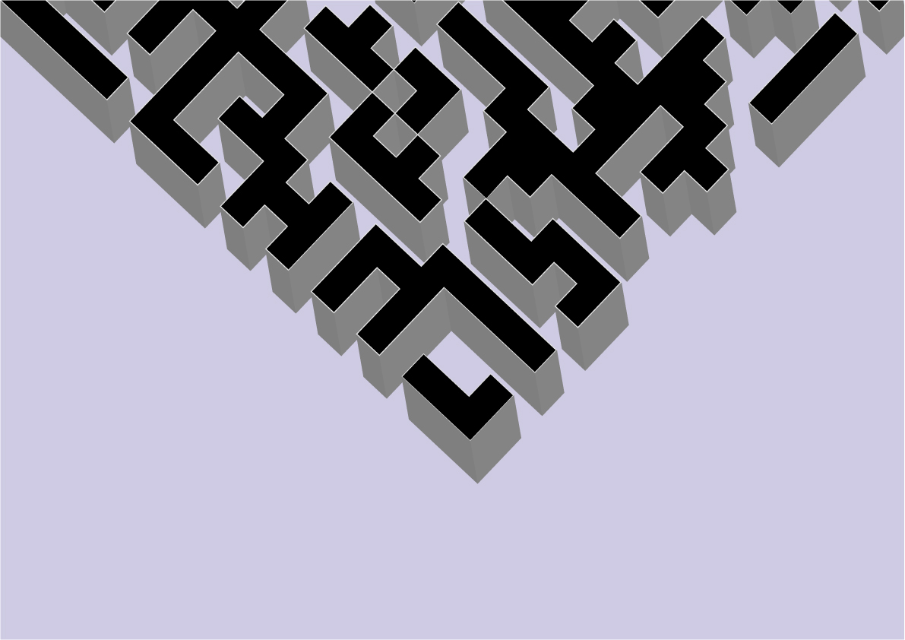

TMR

Slide 2
Table of Contents
About our team
Our goal
Stages of Realisation
Apps/Language that we used
Block-Scheme
Future Ideas
Demonstration
Thank you for your attention

Slide 3

About our team
Petya Petkova | Scrum Trainer
Dimitar Grudov | Back-End Developer
Vesela Dekova | Front-End Developer
Kameliya Yaneva | QA Engineer

Slide 4

OUR GOAL
Maze game with three levels and good structured menu

Slide 5

Stages of Realisation
Organisation
Realisation
Presenting the
final product

Slide 6





Logos and Design

Slide 7






Apps/Language that we used

Slide 8
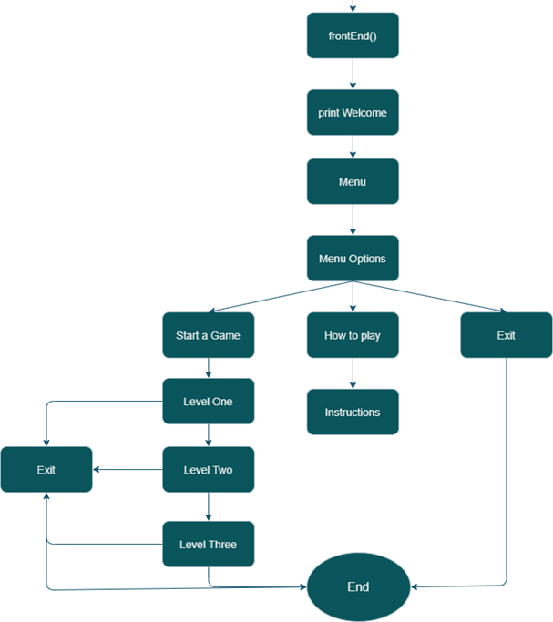
Block-Scheme

Slide 9

Future Ideas
To add Multiplayer
To add timer
To add score

Slide 10
Demonstration

Slide 11
Thank you for your attention!

